Slide 1
Building AN ARTIFICIALLY INTELLIGENT MACHINE
USING ATARI 2600 TO EMPHASIZE THE VIABLITIY OF REINFORCEMENT LEARNING
By Nathan Metze

Slide 2
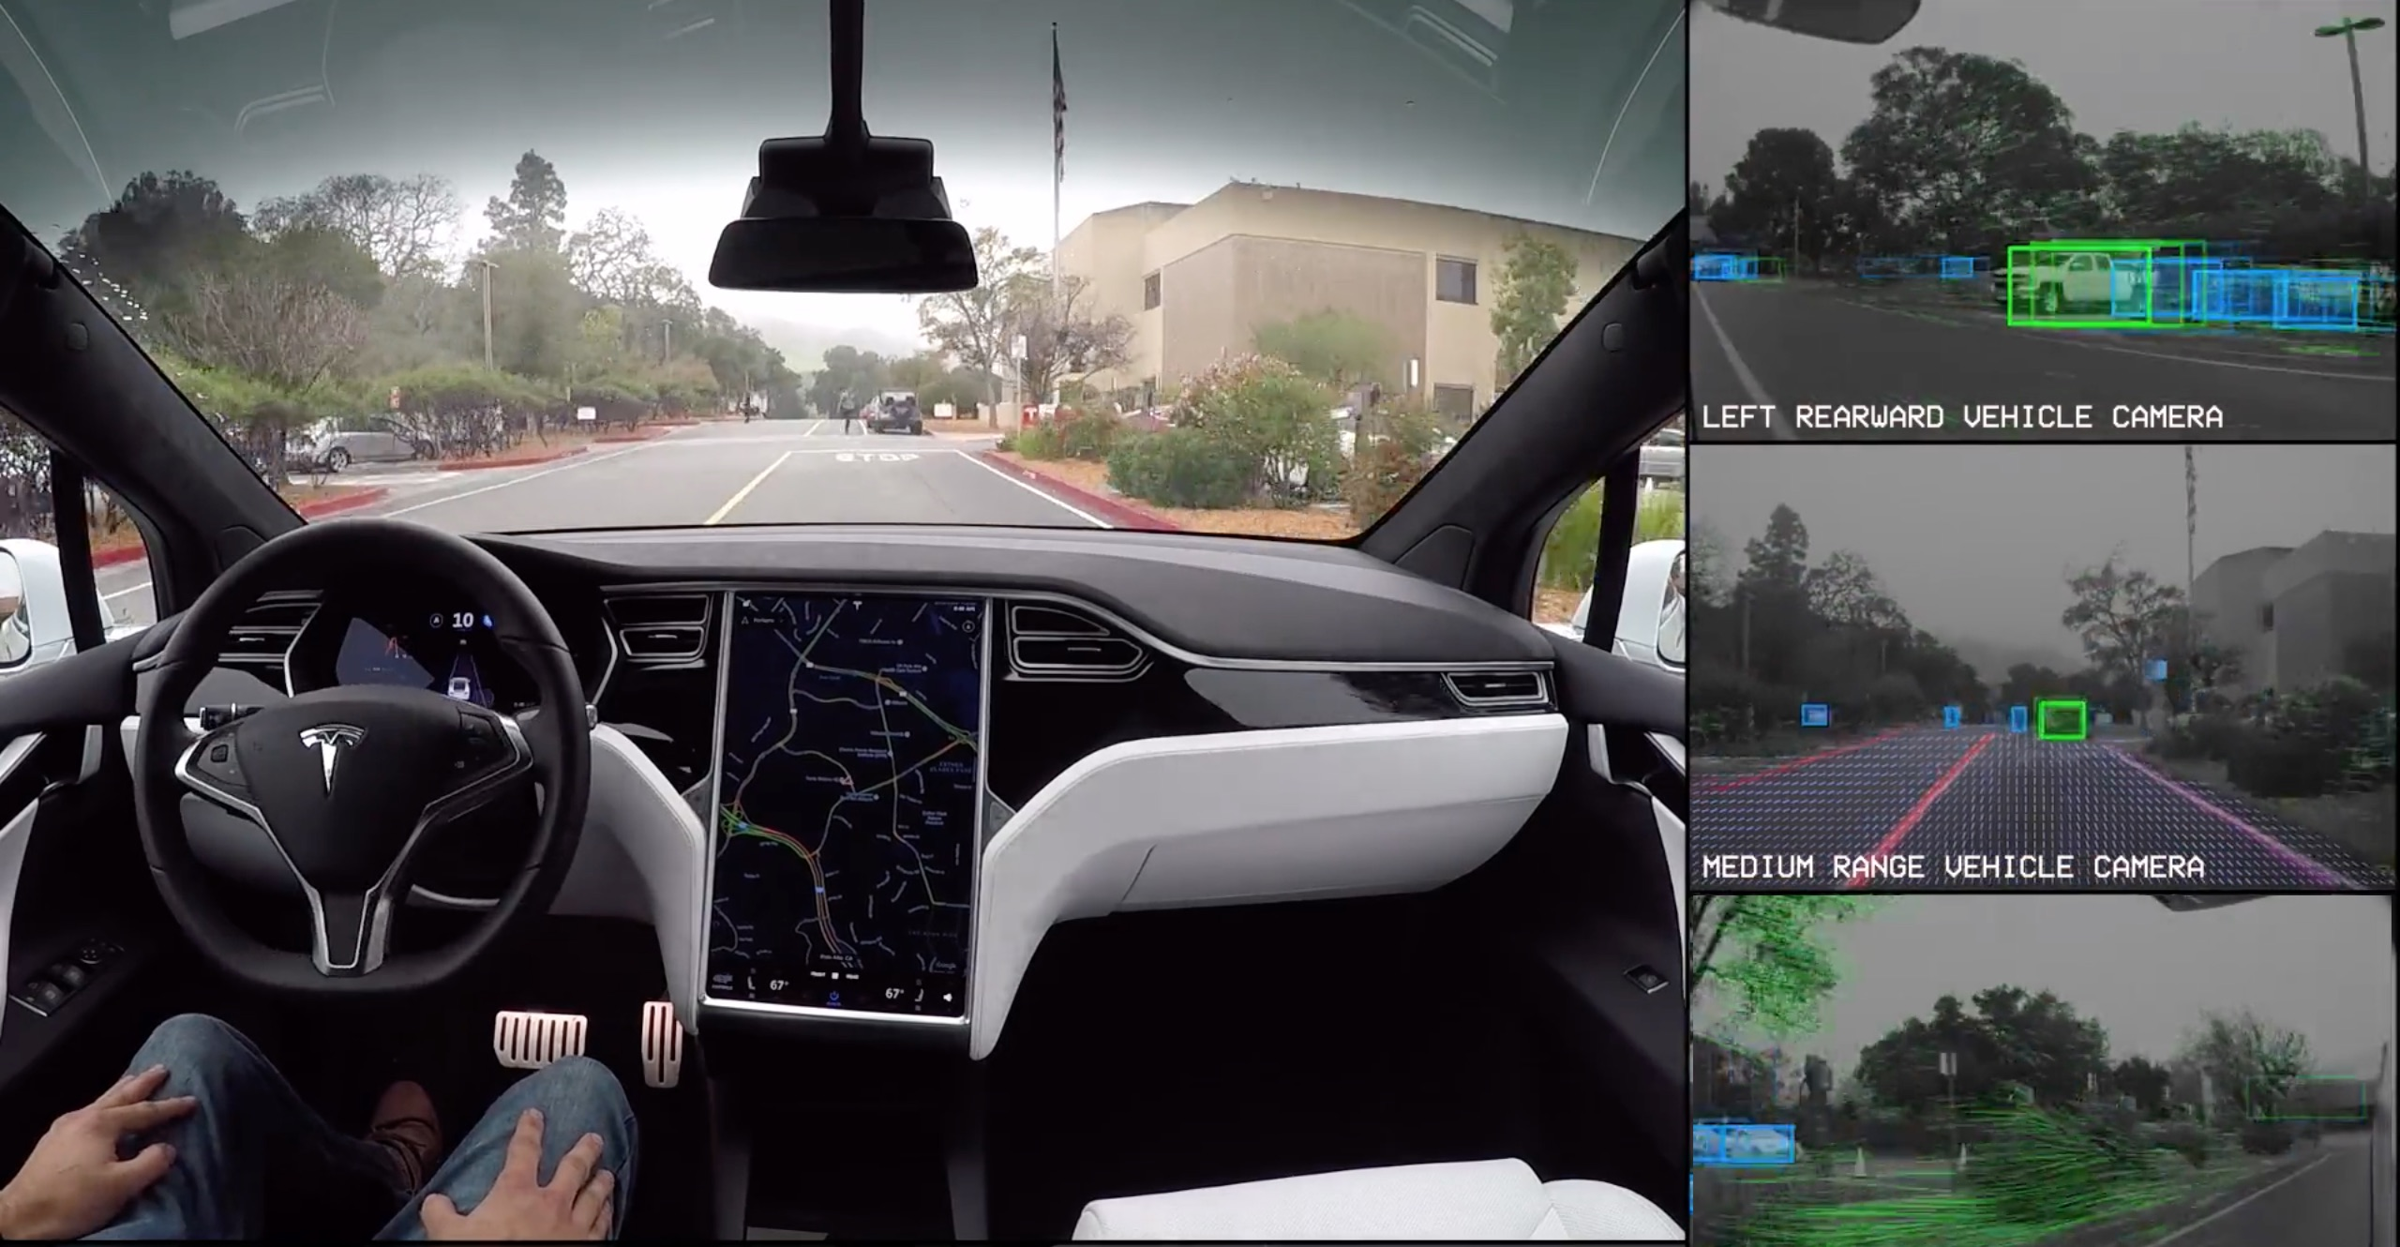
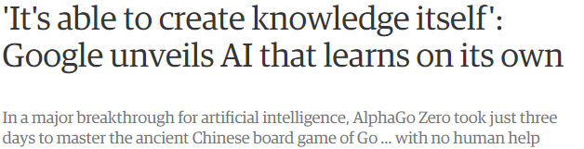
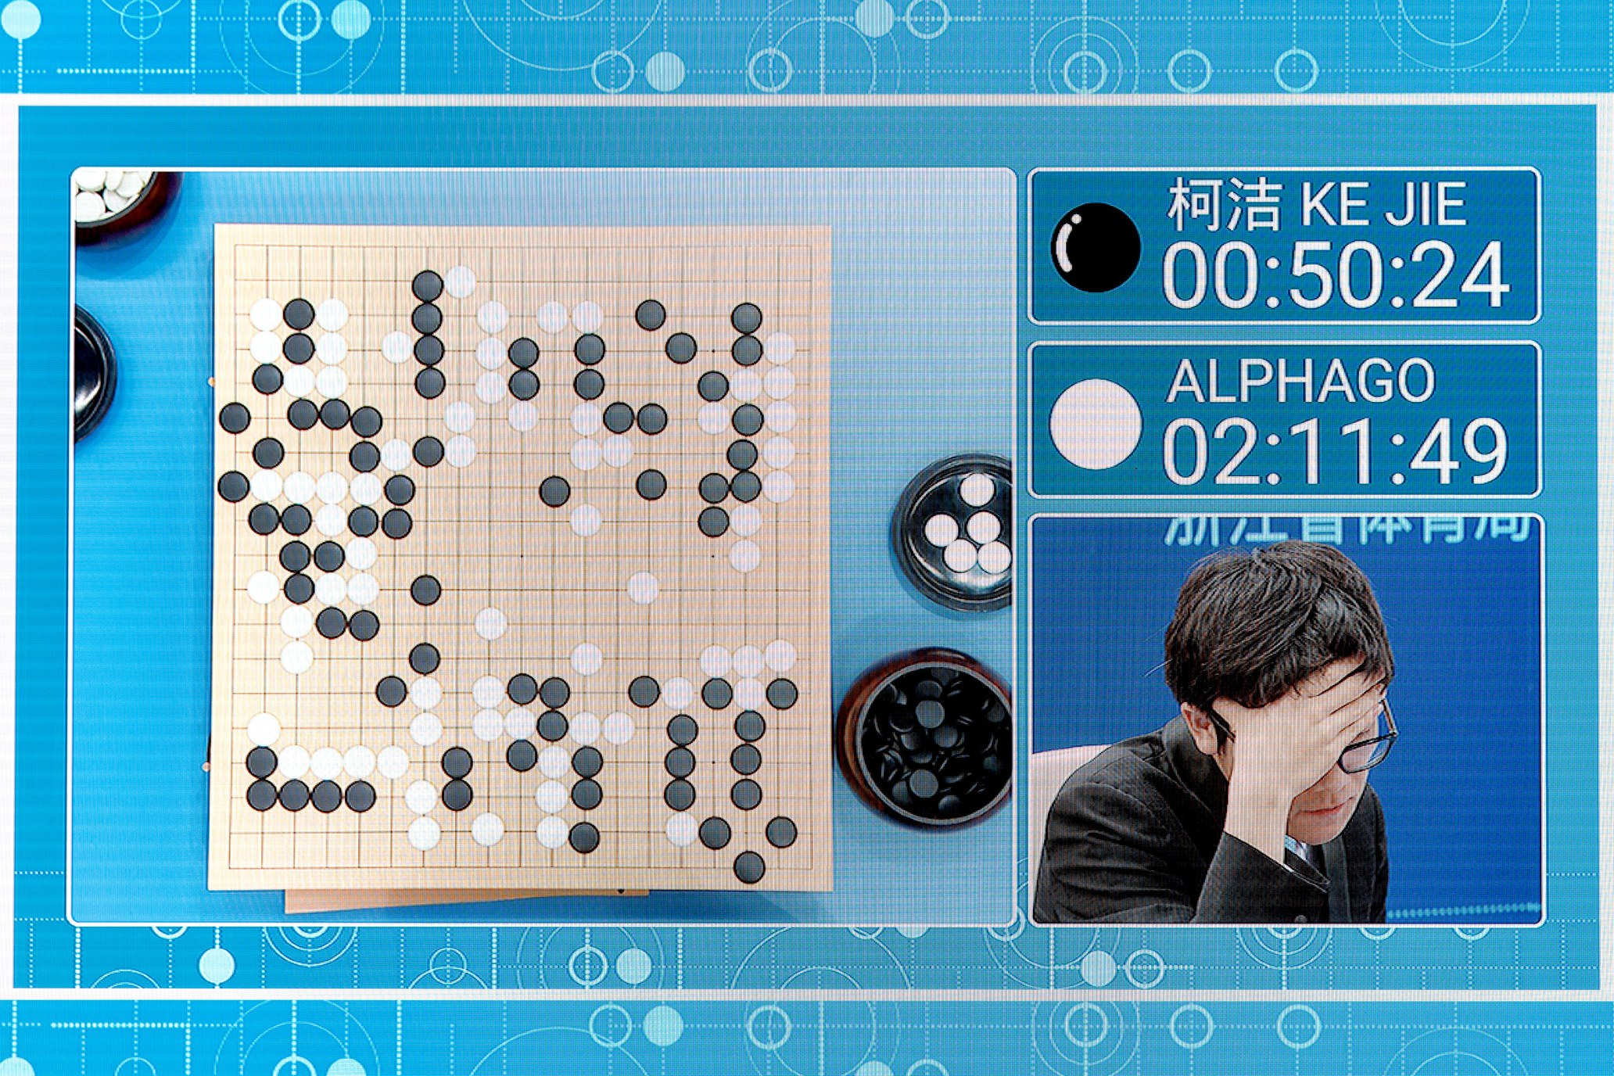
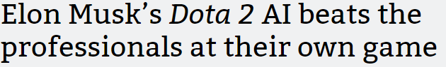
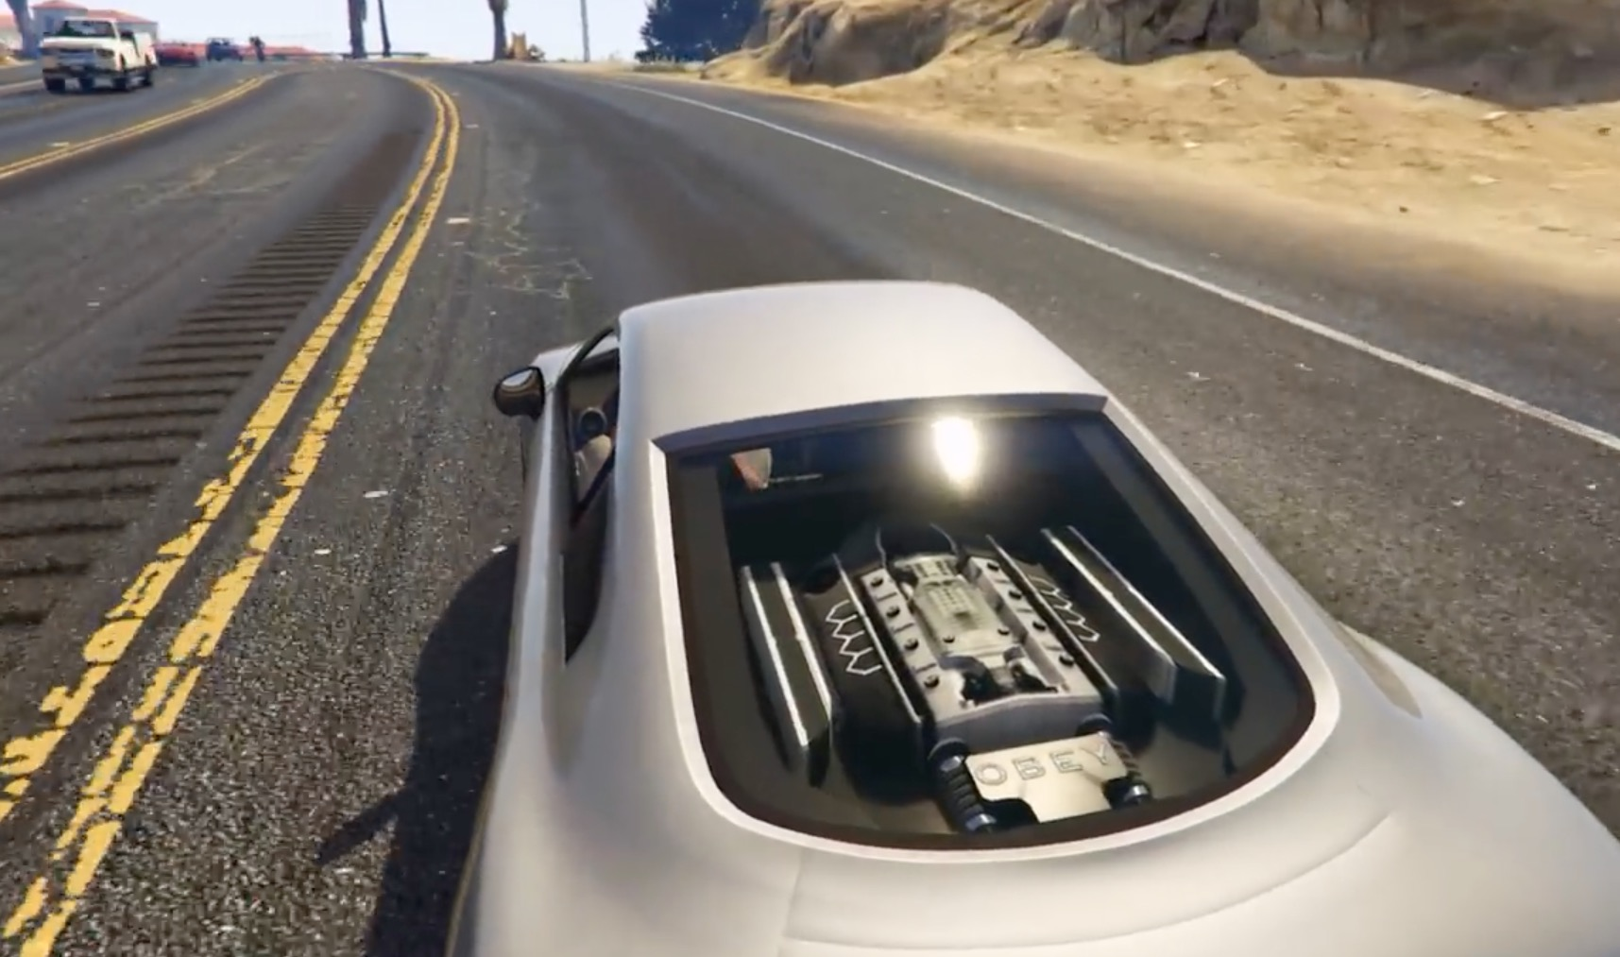
WHY IS IT interesting?

Slide 3

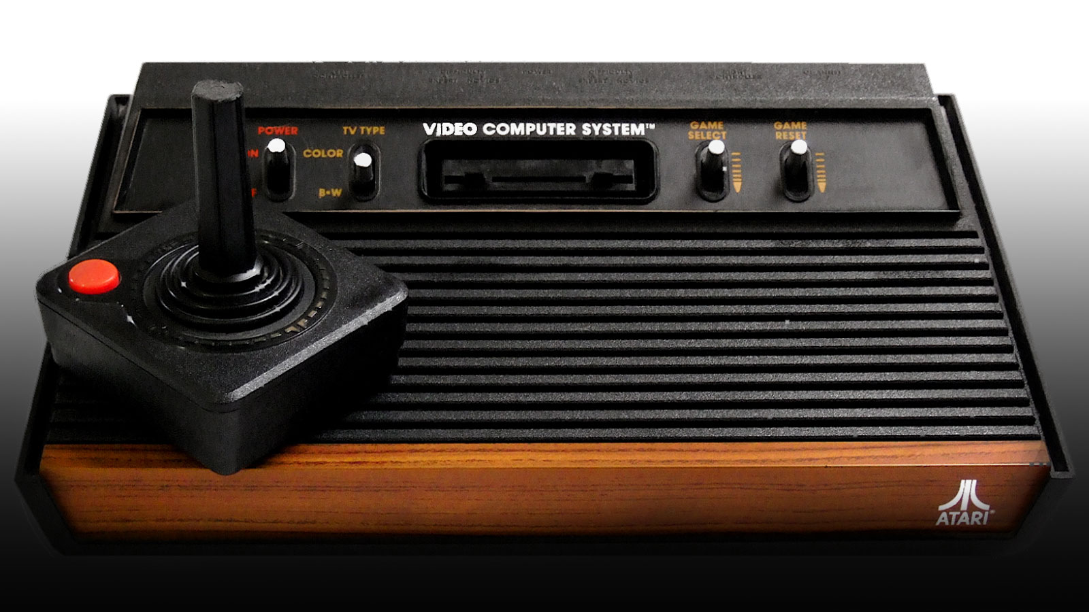


The Game
“Enduro, programmed by Larry Miller and released by Activision in 1983, is a racing game for the Atari 2600 that challenged players to race through day and night conditions as well as weather changes”

Slide 4
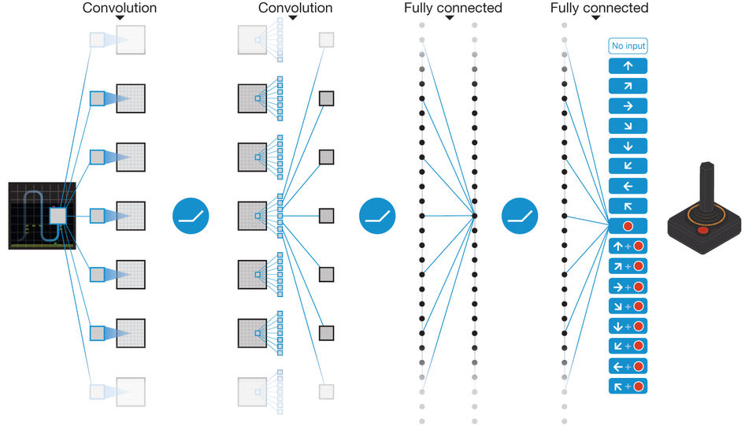
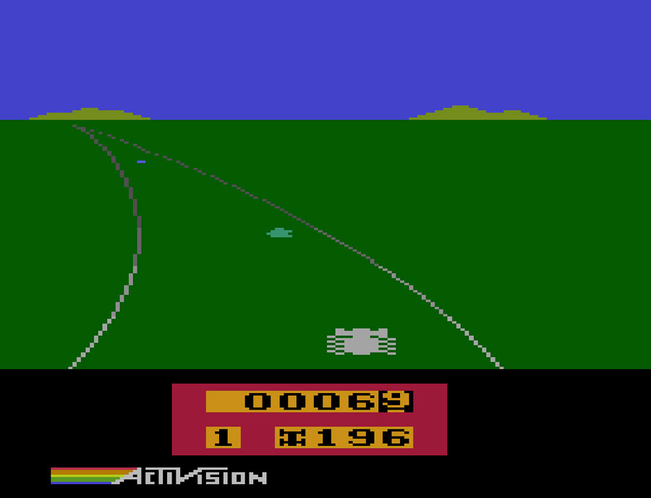

How was it accomplished
$Q^{∗}\left(s,a\right)=max\sum{\left[r_{t}+yr_{t+1}+y^{2}r_{t+2}+ … \left|s_{t}\right.=s, a_{t}=a, π\right]}$

Slide 5
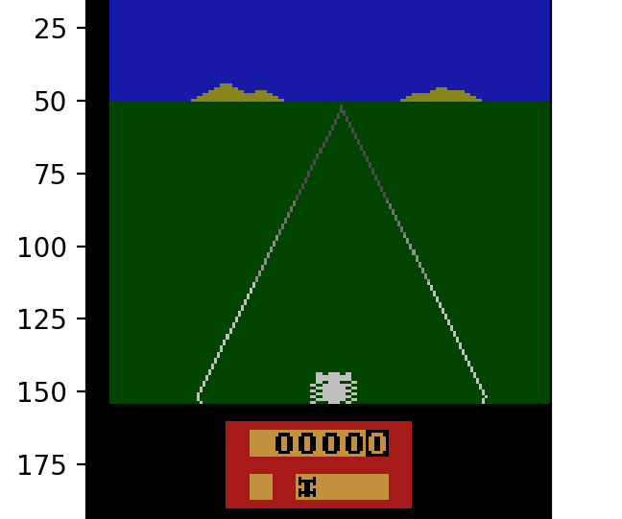
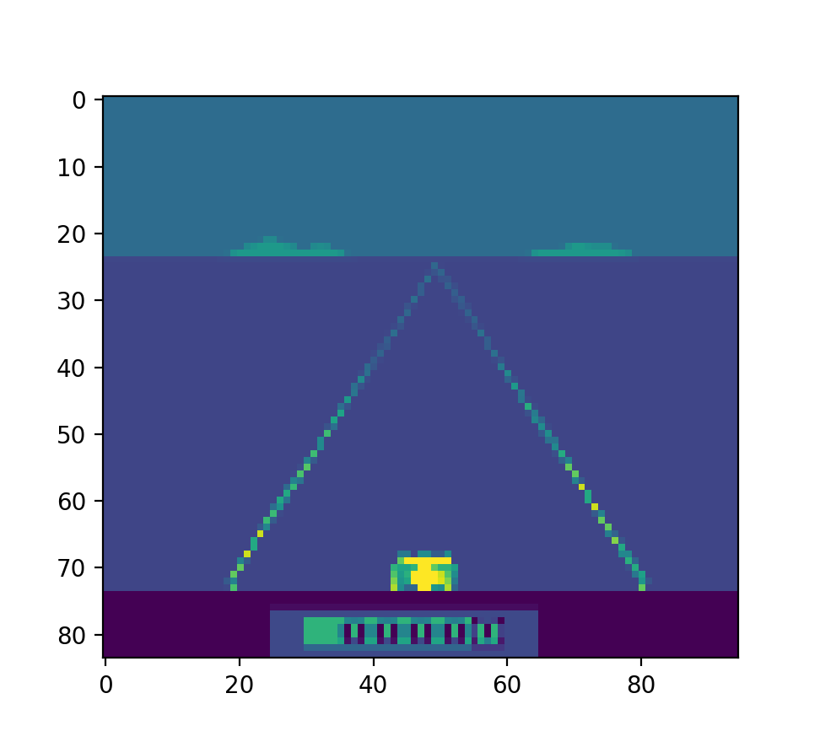
Image Preprocessing
Greyscale
Removes red, green, and blue values
Decreases the 3rd dimension of the image
Each pixel is a representation of the density of the color
Expanding
Image resolution expanded to 100x100
Contours
Removes all extra noise from the image

Slide 6
What the computer sees

Slide 7
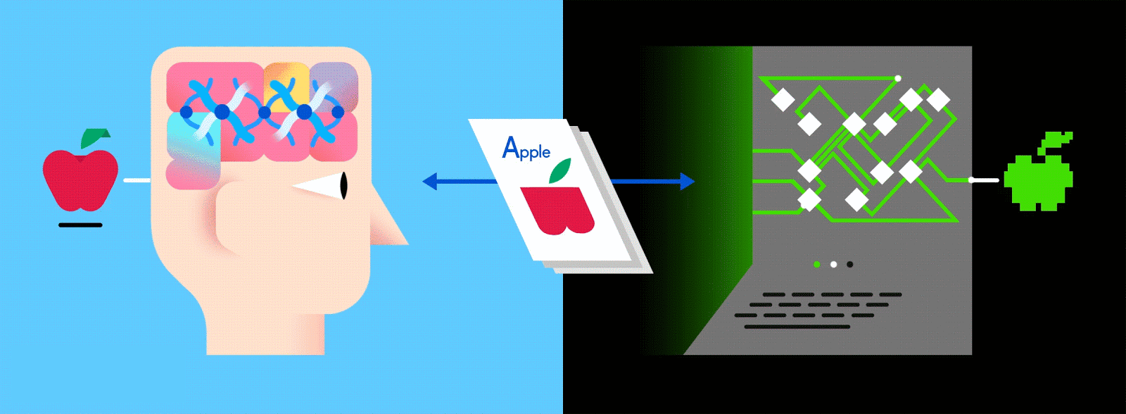
break it down
The Convolutional Neural Network
What is a convolutional neural network
Layered network
Convolutions
Rectified linear unit (ReLU)
Classification
Algorithm capable of high accuracy image classification
Was inspired by biological processes within the visual cortex which emphasizes the connectivity between neurons

Slide 8

Convolutions
Performs feature extraction while maintaining spatial relationships between the pixels
Classes
Number of times filters were applied
Filter
Feature detector used to produce the filter
Stride
The distance to travel between each computation
Layer | Classes | Filter | Stride | Activation
Convolution-1 | 32 | 8x8 | 4 | ReLU
Convolution-2 | 64 | 4x4 | 2 | ReLU
Convolution-3 | 64 | 3x3 | 1 | ReLU

Slide 9
So what are some filter types
Identity
Edge
Sharpen
Box Blur

Slide 10
Rectified Linear UNIT (ReLU)
Performed after every convolution
Is a nonlinear operation
Is applied to each individual pixel
Replaces all negative values with zero
Applying ReLU introduces non-linearity to the convolutional layer
Useful since most real world data is not linear
$$Output=Max\left(zero, Input\right)$$

Slide 11
Classification
Fully connected
Every neuron is connected from the past to the next layer
Uses the features to classify the input into specific outputs
Possible game actions
Cheap way of learning nonlinear combinations of features
Layer | Depth | Filter | Stride | Activation
Connected-1 | 512 | N/A | N/A | ReLU
Connected-2 | # of actions | N/A | N/A | Linear

Slide 12


Q-Learner
$Q^{∗}\left(s,a\right)=max\sum{\left[r_{t}+yr_{t+1}+y^{2}r_{t+2}+ … \left|s_{t}\right.=s, a_{t}=a, π\right]}$
$$π$$
Used to approximate the optimal action-value function used to determine actions
Hypothetically will select actions that will maximize future rewards
$r_{t}$
Sum of rewards
$y$
Discount rate
$t_{}$
Time-step
$π$
Behavior policy
How the Convolutional Neural Network is used
Used to approximate the action-value function
More efficient
Requires less calculations

Slide 13
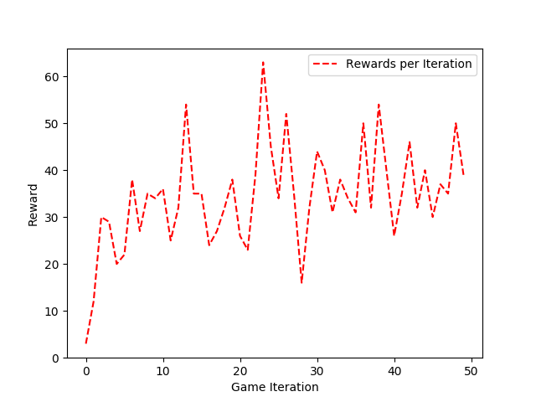
RESULTS
Time Spent Training
10 days
Frames Processed
11,115,632
Hyperparameters:
gamma: 0.95 (reward discount rate)
epsilon: 1.00 (exploration rate)
epsilon decay: 0.99 (rate of decay)
max frames: 200,000 (frames saved)
mini batch size: 32 (sample size)
Frames Processed:
11,115,632
Frames Processed:
11,115,632
Frames Processed:
11,115,632

Slide 14
Difficulties
Memory matrix = [new images, actions, reward, old images, terminal]
New image = 84x95x4
Actions = 1x9
Reward = 1|0
Old image = 84x95x4
Terminal = True|Flase
With memory matrix size of 200,000
12,770,200,000 total items ~ 8GB

Slide 15
What TO do differently
Choose a game with more defined parameters
Make it so the algorithm can be used on multiple games
Shrink the image to allow for more saved instances
Run the program for a longer period of time

Slide 16
Enhancements
Bigger memory matrix
Prioritization of specific frames over others
Attempt at general intelligence

Slide 17

Conclusion and thanks
$Q^{∗}\left(s,a\right)=max\sum{\left[r_{t}+yr_{t+1}+y^{2}r_{t+2}+ … \left|s_{t}\right.=s, a_{t}=a, π\right]}$

Slide 18
SOURCES
1. “An Intuitive Explanation of Convolutional Neural Networks.” The Data Science Blog, 11 Aug. 2016, ujjwalkarn.me/2016/08/11/intuitive-explanation-convnets/.
2. Chuchro, Robert, and Deepak Gupta. “Game Playing with Deep Q-Learning Using OpenAI Gym.”
2. Deshpande, Adit. A Beginner's Guide to Understanding Convolutional Neural Networks, adeshpande3.github.io/adeshpande3.github.io/A-Beginner%27s-Guide-To-Understanding-Convolutional-Neural- Networks/.
3. “Enduro.” Giant Bomb, www.giantbomb.com/enduro/3030-6844/.
4. stats.stackexchange.com/questions/116362/what-does-the-convolution-step-in-a-convolutional-neural-network-do.

